Slide 1

RAGHU ENGINEERING COLLEGE
(Autonomous)
Affiliated to JNTU GURAJADA, VIZIANAGARAM Approved by AICTE, Accredited by NBA, Accredited by NAAC with A+ Grade
CSE-AIML
2022-2026
Under the Esteemed Guidance Of:
Mrs. D. R. S. Swetha
(Assistant Professor)
Submitted By:
JALLA JAGANNADHA RAO
23985A4204
CSE(AIML)

Slide 2
SKILL DZIRE
ARTIFICIAL INTELLIGENCE
INTERNSHIP

Slide 3
TABLE OF CONTENTS:
Introduction to Artificial Intelligence
Applications of Artificial Intelligence
AI-Data Understanding
AI-Big Data
Machine learning fundamentals
Deep learning
Natural language processing
Annexure
Conclusion

Slide 4
INTRODUCTION:
Artificial Intelligence (AI) refers to the development of computer systems that can perform tasks typically requiring human intelligence.These tasks include activities such as learning, reasoning, problem-solving, understanding language, and even perceiving the world in a way that resembles human senses.
In essence, AI enables machines to:
Perceive their environment through data input like images, speech, and text.
Analyze data and extract meaningful information or patterns.
Act based on learned information to make decisions, predictions, or recommendations.
Learn from experience, adjusting their actions or predictions over time without explicit programming.

Slide 5
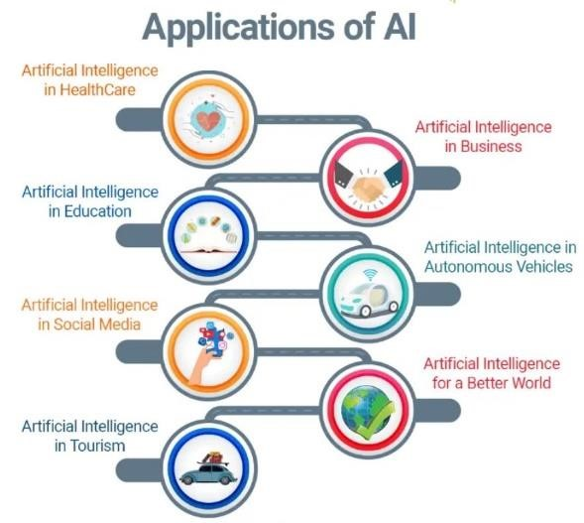
APPLICATIONS OF ARTIFICIAL INTELLIGENCE:
Marketing
Banking
Finance
Agriculture
HealthCare
Gaming
Space Exploration
Autonomous Vehicles
Chatbots
Artificial Creativity

Slide 6
AI-DATA UNDERSTANDING:
AI data understanding is the process of using artificial intelligence (AI) to analyze and interpret data to gain insights and make predictions.
Here are some ways AI data understanding can help:
Automate data analysis -AI can automate many of the tasks that data analysts traditionally do, such as cleansing, inspecting, and modeling data.
Identify patterns-AI can identify patterns and trends in data to help analysts make informed decisions.
Some examples of how AI data understanding can be used include:
Predicting sales - A retail company can use AI to analyze past sales data, customer behavior, and trends to predict future sales.

Slide 7
AI-BIG DATA:
Big Data's Role in AI: Big data refers to extremely large datasets that can be analyzed computationally to reveal patterns, trends, and associations, especially relating to human behavior and interactions.
AI, particularly machine learning, thrives on data to learn and make predictions. The more data AI has, the better it becomes at making accurate predictions or decisions.
Training Machine Learning Models: AI models, especially deep learning, require vast amounts of data to learn complex patterns. Big data provides the fuel for these models to train effectively.
Data-Driven Insights: AI systems analyze big data to provide insights, spot trends, and make decisions that would be difficult or impossible for humans to do manually.

Slide 8
MACHINE LEARNING FUNDAMENTALS:
Machine learning is a branch of artificial intelligence that allows computers to learn from data and make decisions without being explicitly programmed.
It relies on several key fundamentals, starting with data, which can include various types such as numbers, text, or images.
Algorithms play a crucial role in analyzing this data and identifying patterns, with common types including supervised learning, unsupervised learning and reinforcement learning.
The process of training involves teaching the model using a dataset, where it adjusts its parameters to recognize patterns and make predictions.
After training, the model is tested on new, unseen data to evaluate its accuracy and performance.

Slide 9
DEEP LEARNING:
Deep learning is a specialized area of machine learning that uses neural networks with many layers to analyze and understand complex data.
Neural Networks: These are inspired by the human brain and consist of interconnected nodes that process information. Each layer of the network extracts different features from the data, starting from simple features in the first layer to more complex features in deeper layers.
Layers: A deep learning model typically has an input layer (where data is fed in), several hidden layers (where processing happens), and an output layer (where predictions or classifications are made). The depth of the model allows it to learn intricate patterns in large datasets.

Slide 10
NATURAL LANGUAGE PROCESSING:
Natural Language Processing (NLP) is a branch of artificial intelligence that focuses on enabling computers to understand, interpret, and generate human language in a meaningful way.
This involves processing text or speech and breaking it down into its components, such as words and sentences, so that machines can comprehend their meaning.
NLP is widely used in applications like chatbots, language translation, sentiment analysis (which determines the emotional tone of text), and speech recognition.
understanding human language is complex due to factors like context, slang, idioms, and the varying meanings of words, making NLP a challenging and dynamic area of study.

Slide 11
ANNEXURE:
Tic-tac-toe Implementation in AI Using Python:
To implement Tic-Tac-Toe using AI in Python, we can create a simple game where a human player competes against an AI. The AI can use the Minmax algorithm to make optimal moves.
The AI considers two outcomes:
If the AI wins: This is the best possible outcome for the AI, and Minmax will assign a score of +1 to that outcome.
If the AI loses: This is the worst outcome for the AI, and it will assign a score of -1.
If the game ends in a draw: This is a neutral outcome, and Minmax will assign a score of 0. The AI looks ahead at all possible moves and tries to minimize the maximum possible loss (hence "Minmax").

Slide 12
CODE:
import random
class TicTacToe:
def _init_(self): # Corrected constructor
self.board = []
self.human_player = 'X' # Human is 'X'
self.ai_player = 'O' # AI is 'O'
def create_board(self):
self.board = [] # Reset board for a fresh game
for i in range(3):
row = []
for j in range(3):
row.append('-')
self.board.append(row)
def get_random_first_player(self):
return random.randint(0, 1)
def fix_spot(self, row, col, player):
self.board[row][col] = player
def is_player_win(self, player):
n = len(self.board)
# checking rows
for i in range(n):

Slide 13
Cont.
if all(self.board[i][j] == player for j in range(n)):
return True
for i in range(n): #checking columns
if all(self.board[j][i] == player for j in range(n)):
return True
if all(self.board[i][i] == player for i in range(n)): # checking diagonals
return True
if all(self.board[i][n - 1 - i] == player for i in range(n)):
return True
return False
def is_board_filled(self):
for row in self.board:
for item in row:
if item == '-':
return False
return True
def swap_player_turn(self, player):
return 'X' if player == 'O' else 'O'
def show_board(self):
for row in self.board:
for item in row:

Slide 14
Cont.
print(item, end=" ")
print()
def get_empty_spots(self):
empty_spots = []
for i in range(3):
for j in range(3):
if self.board[i][j] == '-':
empty_spots.append((i, j))
return empty_spots
# Minimax algorithm to evaluate best move for AI
def minimax(self, is_maximizing):
# Base cases: Check for terminal states (win/loss/draw)
if self.is_player_win(self.ai_player):
return 1
if self.is_player_win(self.human_player):
return -1
if self.is_board_filled():
return 0
if is_maximizing: # Maximizing player's move (AI)
if score >best_score:

Slide 15
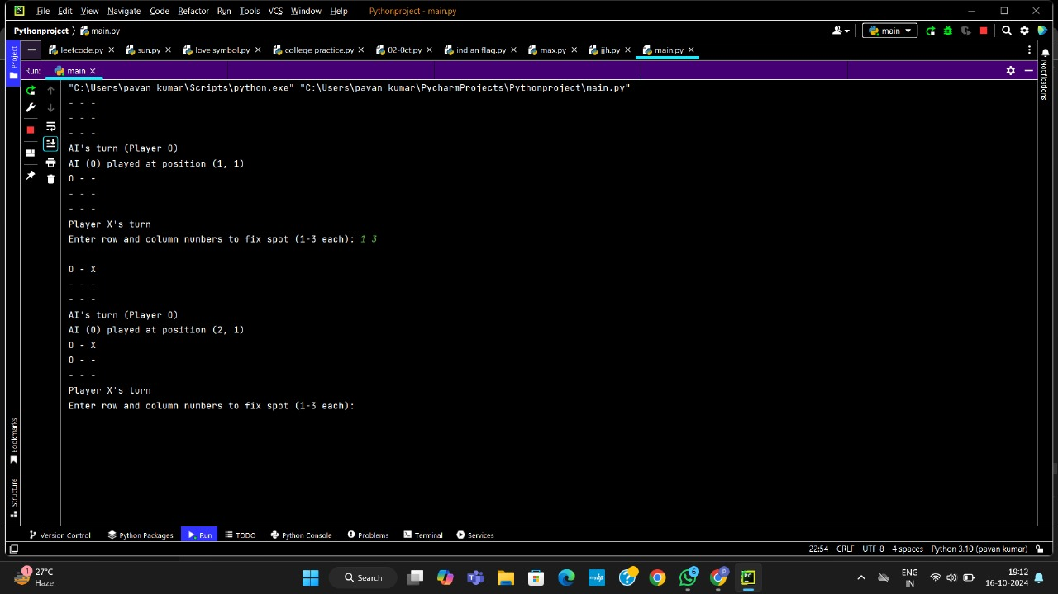
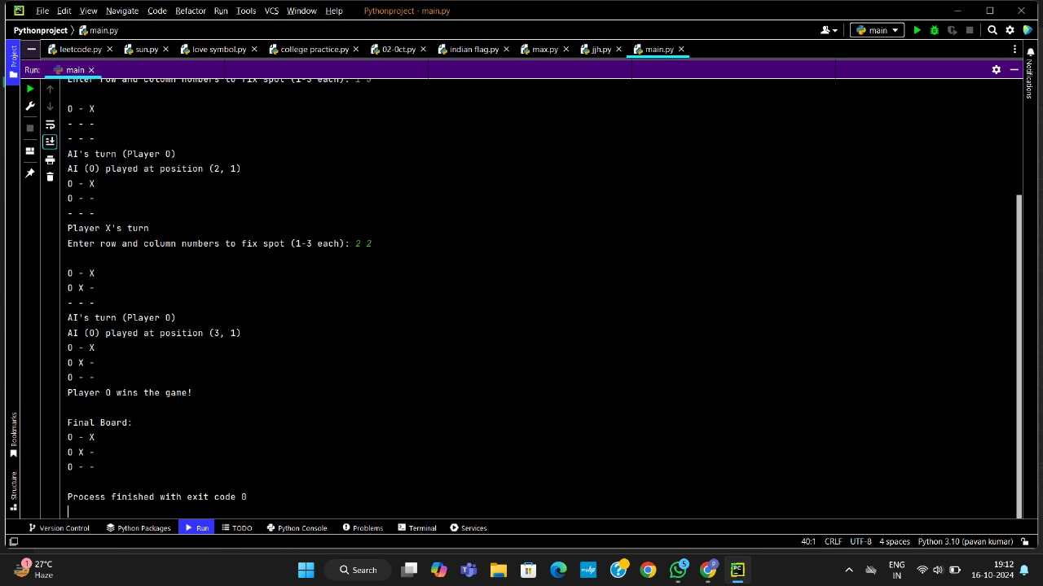
Cont.
//AI WINS
best_score = -float('inf')
for (row, col) in self.get_empty_spots():
self.board[row][col] = self.ai_player
score = self.minimax(False) # Minimize opponent's score
self.board[row][col] = '-' # Undo move
best_score = max(best_score, score)
return best_score
else: # Minimizing player's move (Human)
best_score = float('inf')
for (row, col) in self.get_empty_spots():
self.board[row][col] = self.human_player
score = self.minimax(True) # Maximize AI's score
self.board[row][col] = '-' # Undo move
best_score = min(best_score, score)
return best_score
def ai_move(self): # AI to play its best move
best_score = -float('inf')
best_move = None
for (row, col) in self.get_empty_spots():
self.board[row][col] = self.ai_player
score = self.minimax(False)
self.board[row][col] = '-'

Slide 16
Cont.
best_score = score
best_move = (row, col)
if best_move:
row, col = best_move
self.fix_spot(row, col, self.ai_player)
print(f"AI ({self.ai_player}) played at position ({row + 1}, {col + 1})")
def start(self):
self.create_board()
# Randomly decide who goes first
player = 'X' if self.get_random_first_player() == 1 else 'O'
while True:
self.show_board()
if player == 'X': # User's turn
print(f"Player {player}'s turn")
# Taking user input
row, col = list(map(int, input("Enter row and column numbers to fix spot (1-3 each):").split()))
print()
# Validating the move
if self.board[row - 1][col - 1] != '-':
print("This spot is already taken. Try again.")

Slide 17
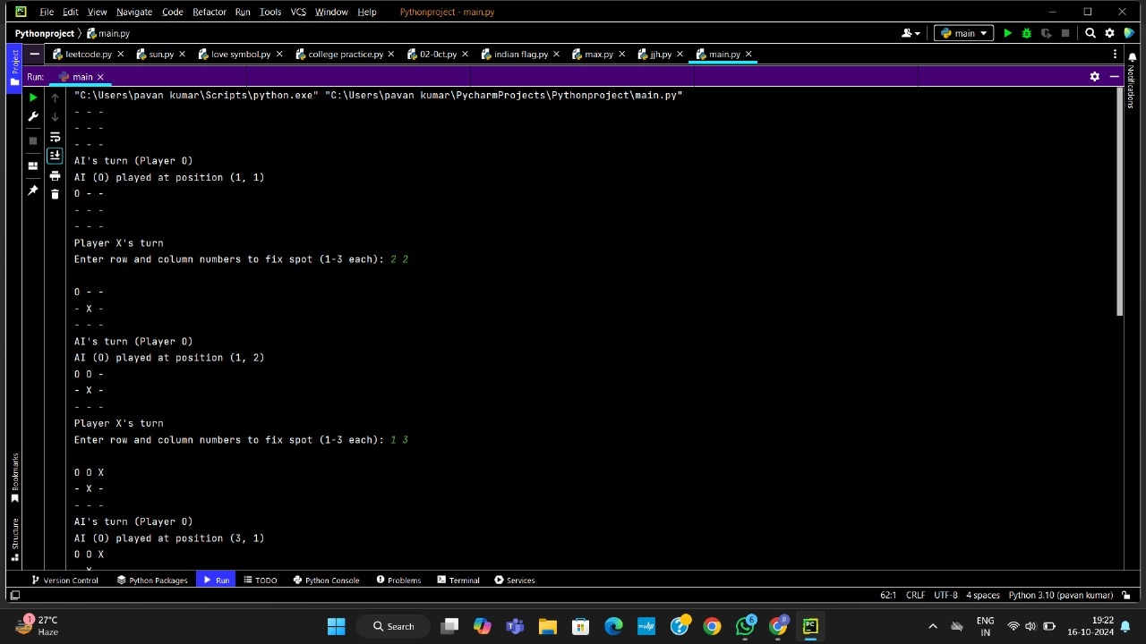
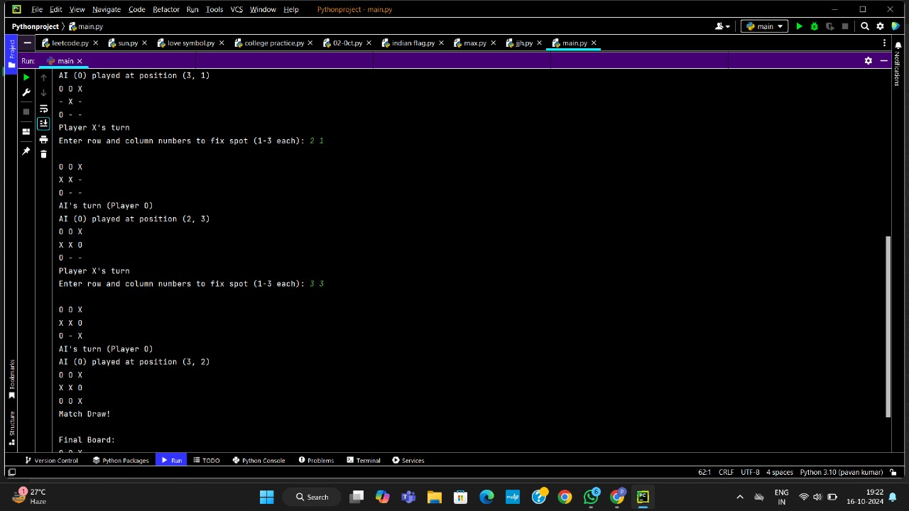
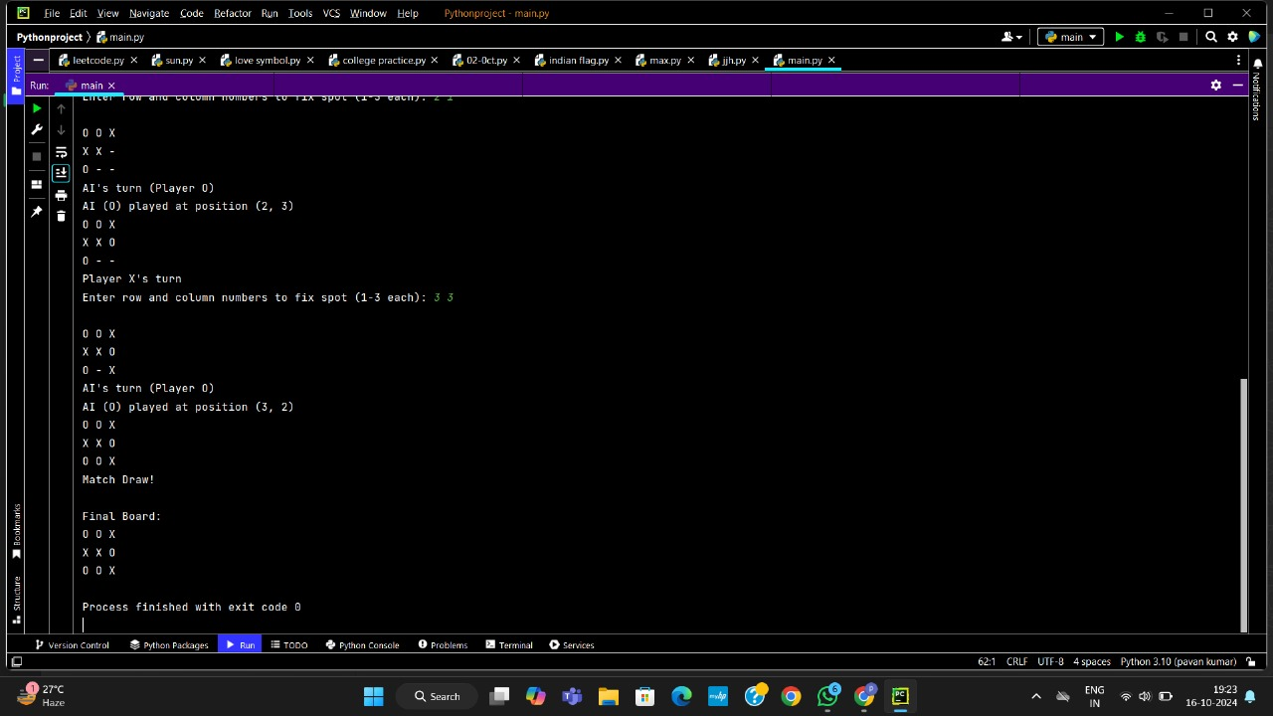
Cont. //DRAW
continue
self.fix_spot(row - 1, col - 1, player)
else: # AI's turn
print(f"AI's turn (Player {player})")
self.ai_move()
# Check if the current player won
if self.is_player_win(player):
self.show_board()
print(f"Player {player} wins the game!")
break
if self.is_board_filled(): # Check if the game is a draw
self.show_board()
print("Match Draw!")
break
# Swap the turn
player = self.swap_player_turn(player) # Swap the turn
print("\nFinal Board:") # Final board view
self.show_board()
# Start the game
tic_tac_toe = TicTacToe()
tic_tac_toe.start()

Slide 18
CONCLUSION:
The Tic Tac Toe project successfully demonstrates key programming concepts such as game logic, user input handling, and basic AI development for game automation.
Through implementing a simple turn-based structure, checking win conditions, and ensuring the game runs smoothly with clear feedback for players, it emphasizes how fundamental principles like loops, conditionals, and arrays work together to create an interactive experience.
Whether played by two users or against a basic AI, this project highlights the importance of clean code design and problem-solving in game development.

Slide 19
THANK YOU

